Slide 1
Student Management system-using crud spring boot
Bouvthika RM

Slide 2
Abstract
The main aim to design a’ student management system’. To aware STUDENT list to the teacher. Using spring boot to create project output. Eclipse workspace without installing to local maven repository. Hibernate to provides a framework for mapping an object-oriented domain model to relational database. It generates SQL calls and relieves the developer from the manual handling and object conversion of the result set.

Slide 3
Aim –to build spring boot maven project
Required:
JDK
Eclipse
JPA
Spring Boot
Mysql workbench

Slide 4
Steps to create Spring Boot Project
Required:
Dependencies:
Spring web
Spring Dev-tool
Mysql driver
Jpa for hibernate
Create Spring boot Maven .
Add dependencies
Application.Properties
Create java classes
MVC using Html

Slide 5
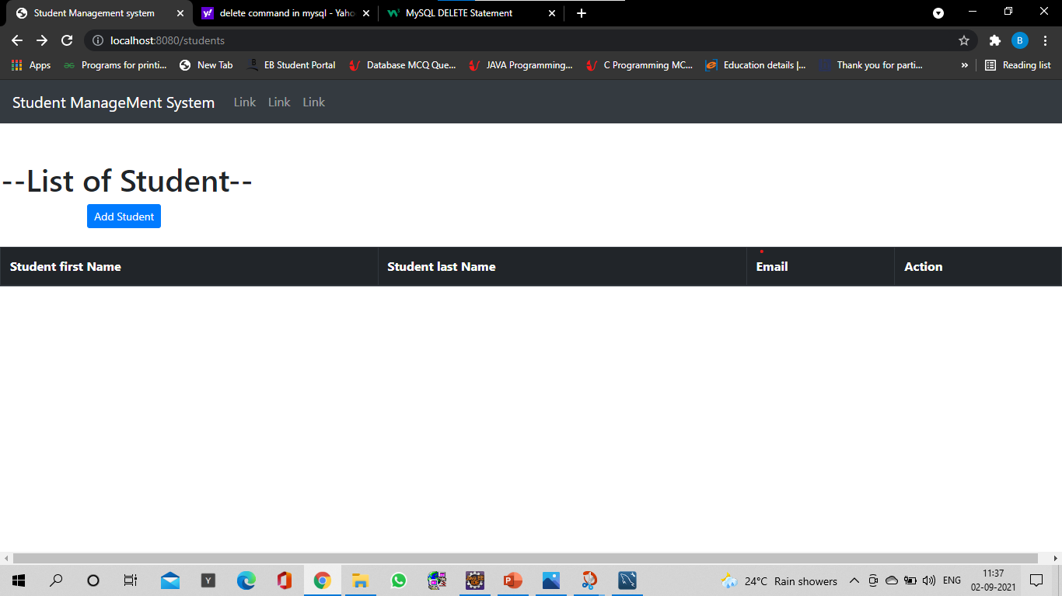
Student List page
This Page Contain “Add Button” To Save A Student to save student details.
Each row has Update and Delete button to update and delete student detail.

Slide 6
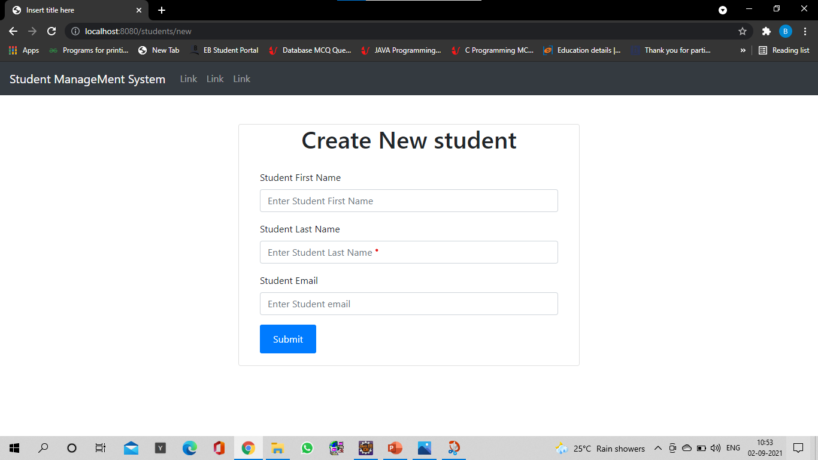
Create Student details page
This Page create student details. you can get this page by clicking a Add Student on /students.html page.
You can submit the details through submit button
After submit you will receive details in Table in /students.html page.

Slide 7
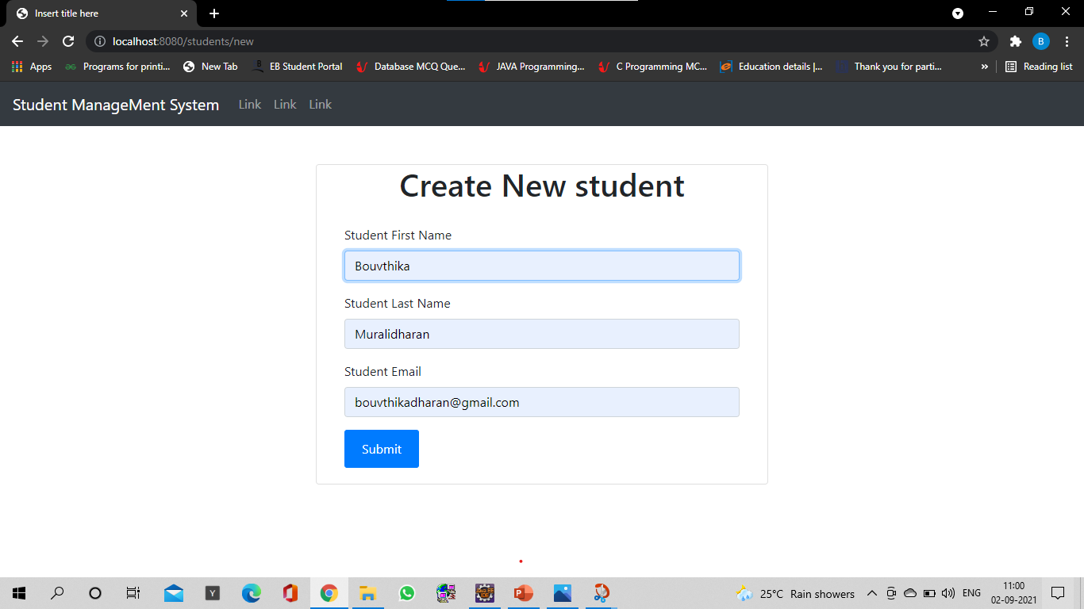
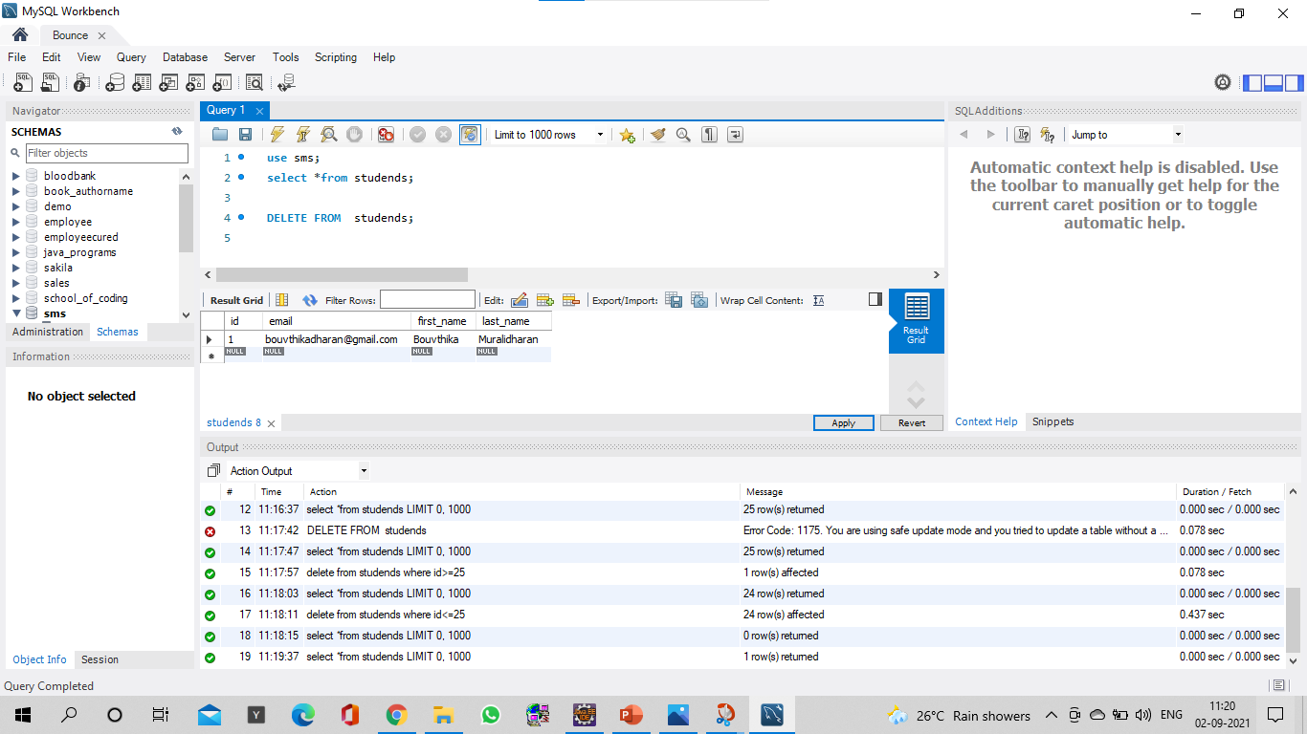
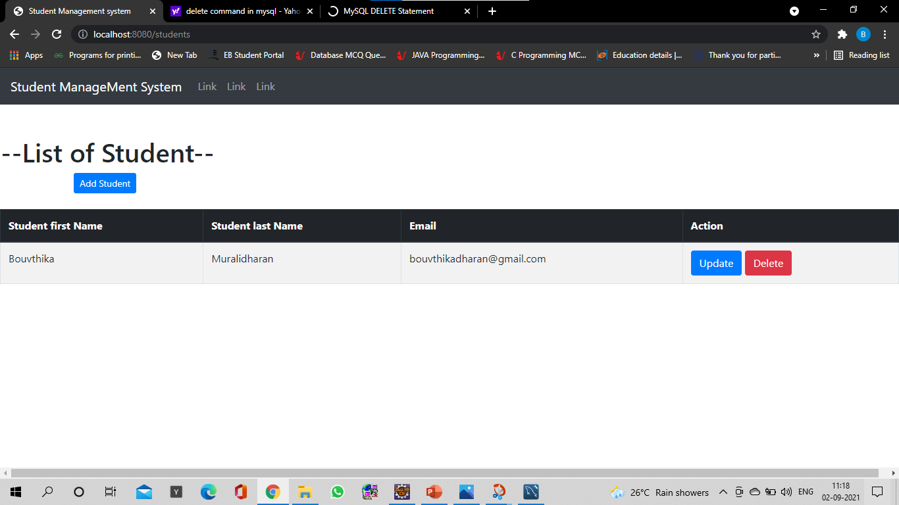
Create Student details page-action
By submitting details in create student details
It is add to table in student list and Mysql page.

Slide 8
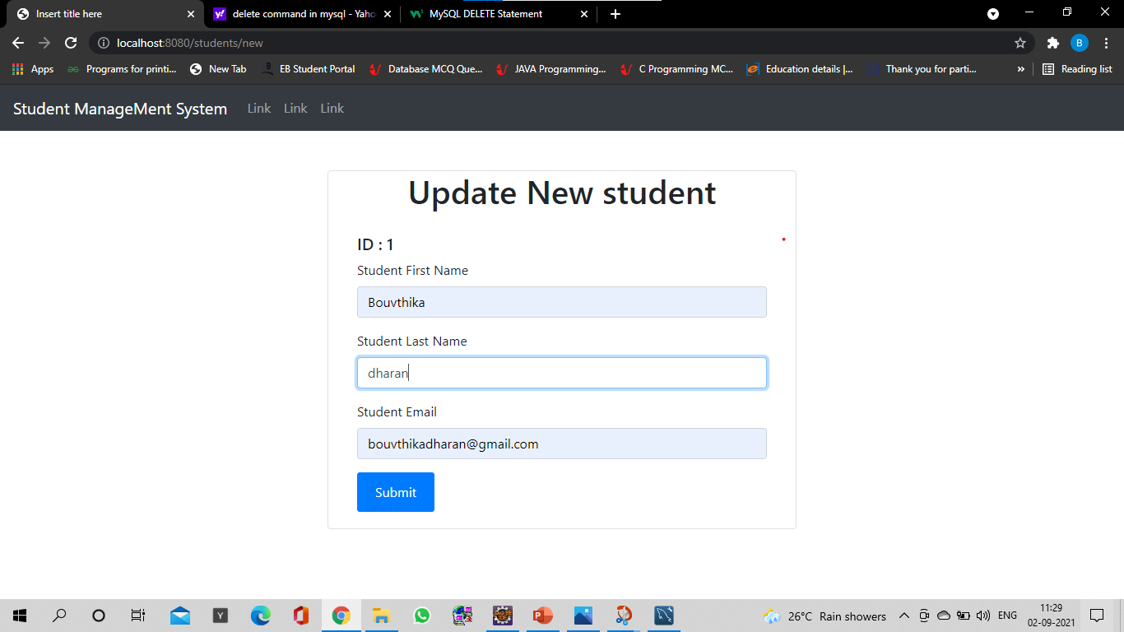


update Student details page-action
Here in place of Last Name I had changed “Muralidharan” into “dharan”. You can see through the image.

Slide 9
Delete Student details page-action
By click delete its easy to delete.

Slide 10

Thank you ……. Have a sun shine

